Slide 1


Secure Data Flow
SE3331-1
IPADS, Shanghai Jiao Tong University
https://www.sjtu.edu.cn
Notes:
Credits to Mike Freedman (COS 461) and others.

Slide 2
Data Flow Protection

Slide 3
Two Usages of Data Flow Tracking
Usage-1: protect critical data
  E.g., track data to ensure none is leaked
Usage-2: defend against suspicious input data
  E.g., one input data cannot flow to return address!

Slide 4
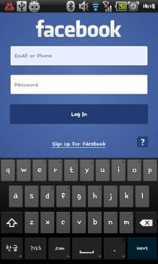
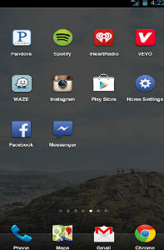
Ways an Attacker Can Steal Your Secrets
KeyLogger: install a KeyLogger/TouchLogger on the phone
Phishing: install a malware and lure the user to enter password
Malicious app
in background,
waiting for the
Facebook app
to launch
Once Facebook app
starts, the malicious
app will get active
and make itself
cover the real UI
Bianchi, Antonio, et al. "What the App is That? Deception and Countermeasures in the Android User Interface.", S&P 2015.
Notes:
Or he can install a malware to lure the user to enter password. A typicall malware will run in background...

Slide 5

Ways an Attacker Can Steal Your Secrets
KeyLogger: install a KeyLogger/TouchLogger on the phone
Phishing: install a malware and lure the user to enter password
MemScan: use rootkit and scan the memory for any plaintext
010100101010101000101010101010101010101010101010010101010101010010101010101010101001010011010101010101010101010001001000000101010010010010
The Samsung memory mapping bug: http://forum.xda-developers.com/showthread.php?t=2048511
Notes:
Or, he can just use rootkit and scan the memory for any plaintext

Slide 6
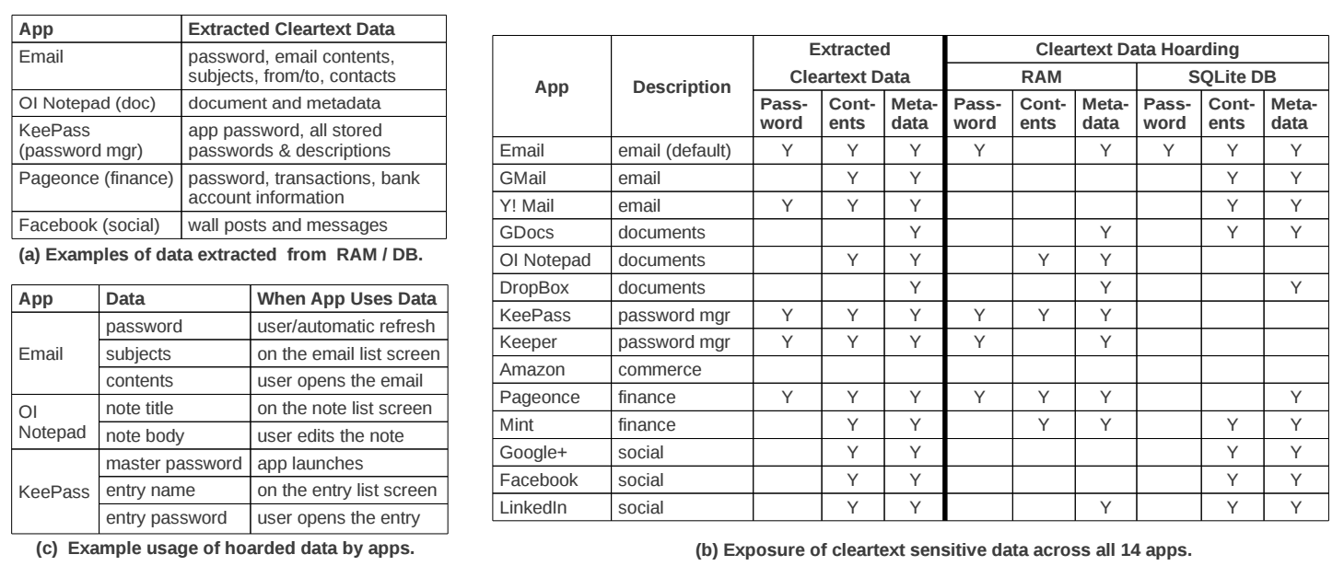
The "Data Residue" Problem
The plaintext of confidential data may exist in memory on a mobile device for a long time
应用对关键数据的保护不够
  引CleanOS的数据
Android's default Email app:
has plaintext of password in RAM 10 minutes after login
Tang, Yang, et al. "CleanOS: Limiting Mobile Data Exposure with Idle Eviction." OSDI. 2012.
Notes:
This attack is simple but effective since the memory does contain many secrets. Here is a table from cleanOS, OSDI'12 paper.
It shows that many popular applications will leave residue of critical data in memory for a long time. For example,
the android's default email app,

Slide 7
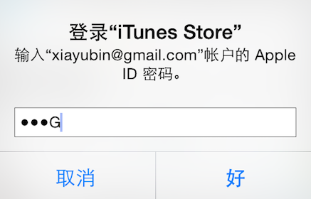
Ways an Attacker Can Steal Your Secrets
KeyLogger: install a KeyLogger/TouchLogger on the phone
Phishing: install a malware and lure the user to enter password
MemScan: use rootkit and scan the memory for any plaintext
ScreenCapture: get information directly from the screen
Jang, Yeongjin, et al. "A11y Attacks: Exploiting Accessibility in Operating Systems." CCS, 2014.
Notes:
The attacker might also steal your password from screen. On iOS system, once you enter a password, the last character will be displayed for a second. If the attacker can access framebuffer or capture the screen, he can get your password

Slide 8
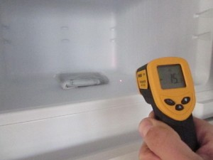
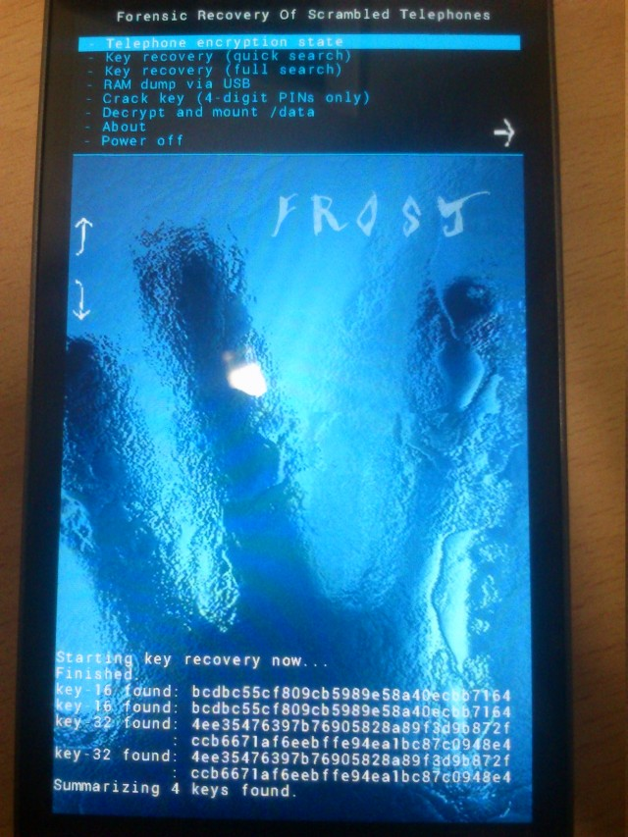
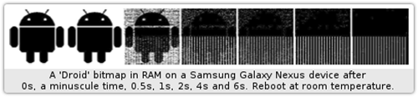
Ways an Attacker Can Steal Your Secrets
KeyLogger: install a KeyLogger/TouchLogger on the phone
Phishing: install a malware and lure the user to enter password
MemScan: using rootkit and scan memory for any plaintext
ScreenCapture: get information directly from the screen
Cold-boot: physically attack that can scan memory to get any plaintext
Müller, Tilo, and Michael Spreitzenbarth. "Frost." Applied Cryptography and Network Security. Springer Berlin Heidelberg, 2013.
Notes:
Cold boot attack is also possible on the mobile device, which just scan the memory to get an plaintext.

Slide 9
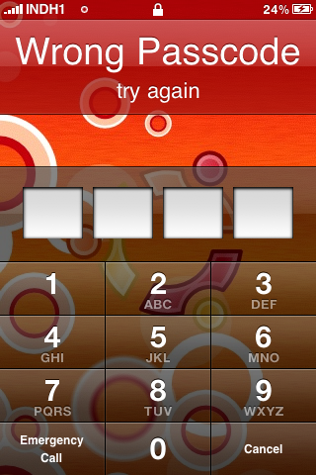
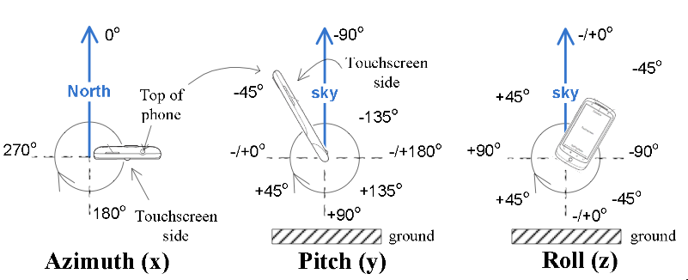
Ways an Attacker Can Steal Your Secrets
KeyLogger: install a KeyLogger/TouchLogger on the phone
Phishing: install a malware and lure the user to enter password
MemScan: using rootkit and scan memory for any plaintext
ScreenCapture: get information directly from the screen
Coldboot: physically scan the memory to get any plaintext
Side-Channel: infer PIN code through motion-detector
Cai, Liang, and Hao Chen. "TouchLogger: Inferring Keystrokes on Touch Screen from Smartphone motion." HotSec. 2011.
Notes:
A even more sophistic attack is to use the motion-detector to guess the user's PIN code, just by learning the relationship between the PIN and phone's inclination when pressing the screen.

Slide 10
Taint Tracking
Data Protection

Slide 11
Data Lifetime
The lifetime of sensitive data should be minimized
  The longer data remains in memory the greater its chances of being leaked to disk
  Swapping, hibernation, VM suspending, core dump, etc.
That's what we called "data exposure"

Slide 12
Tainting: Data Flow Tracking
Apply access policy along the data flow
  E.g., a password cannot be sent to Internet
  E.g., credit card number cannot be sent to other apps
  E.g., untrusted data cannot be executed

Slide 13
Dynamic Taint Analysis
i = get_input();
two = 2;
if(i%2 == 0){
  j = i+two;
  l = j;
} else {
  k = two*two;
  l = k;
}
jmp l;
Example sourced from CMU ECE
  Source
Will show the basic approach of dynamic taint analysis
Two concrete executions will be presented
Goal: evaluate whether control can be hijacked by [malicious] user input

Slide 14
Dynamic Taint Analysis
i = get_input();
two = 2;
if(i%2 == 0){
  j = i+two;
  l = j;
} else {
  k = two*two;
  l = k;
}
jmp l;
Variable | Value | Taint Status

Slide 15
Dynamic Taint Analysis
i = get_input();
two = 2;
if(i%2 == 0){
  j = i+two;
  l = j;
} else {
  k = two*two;
  l = k;
}
jmp l;
Variable | Value | Taint Status
i | 6 | true

Slide 16
Dynamic Taint Analysis
i = get_input();
two = 2;
if(i%2 == 0){
  j = i+two;
  l = j;
} else {
  k = two*two;
  l = k;
}
jmp l;
Variable | Value | Taint Status
i | 6 | true
two | 2 | false

Slide 17
Dynamic Taint Analysis
i = get_input();
two = 2;
if(i%2 == 0){
  j = i+two;
  l = j;
} else {
  k = two*two;
  l = k;
}
jmp l;
Variable | Value | Taint Status
i | 6 | true
two | 2 | false
j | 8 | true

Slide 18
Dynamic Taint Analysis
i = get_input();
two = 2;
if(i%2 == 0){
  j = i+two;
  l = j;
} else {
  k = two*two;
  l = k;
}
jmp l;
Variable | Value | Taint Status
i | 6 | true
two | 2 | false
j | 8 | true
l | 8 | true
Notes:
In this case, the taint analysis would show that an attack is possible. Notice, however, that we don't know exactly how variable L is tainted by variable I as we do in a fully symbolic execution—we only know that the two variables are related. However, computing a fully symbolic execution is often intractable, thus giving dynamic taint analysis some merits as a higher-performance technique (in terms of computational efficiency).

Slide 19
Dynamic Taint Analysis
i = get_input();
two = 2;
if(i%2 == 0){
  j = i+two;
  l = j;
} else {
  k = two*two;
  l = k;
}
jmp l;
Variable | Value | Taint Status

Slide 20
Dynamic Taint Analysis
i = get_input();
two = 2;
if(i%2 == 0){
  j = i+two;
  l = j;
} else {
  k = two*two;
  l = k;
}
jmp l;
Variable | Value | Taint Status
i | 7 | true

Slide 21
Dynamic Taint Analysis
i = get_input();
two = 2;
if(i%2 == 0){
  j = i+two;
  l = j;
} else {
  k = two*two;
  l = k;
}
jmp l;
Variable | Value | Taint Status
i | 7 | true
two | 2 | false

Slide 22
Dynamic Taint Analysis
i = get_input();
two = 2;
if(i%2 == 0){
  j = i+two;
  l = j;
} else {
  k = two*two;
  l = k;
}
jmp l;
Variable | Value | Taint Status
i | 7 | true
two | 2 | false
k | 4 | false

Slide 23
Dynamic Taint Analysis
i = get_input();
two = 2;
if(i%2 == 0){
  j = i+two;
  l = j;
} else {
  k = two*two;
  l = k;
}
jmp l;
Variable | Value | Taint Status
i | 7 | true
two | 2 | false
k | 4 | false
l | 4 | false
Notes:
In this case, the taint analysis would show that an attack is not possible.

Slide 24
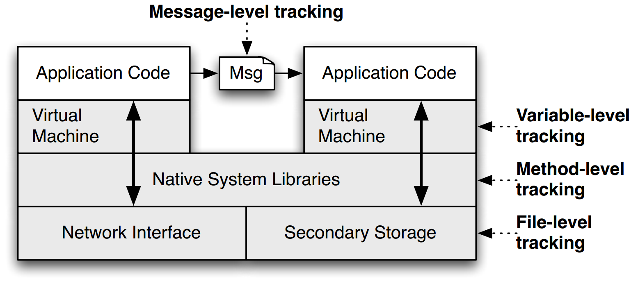
TaintDroid
Notes:
This is a figure from the conference paper describing TaintDroid. It shows where, at a high level, the various kinds of taint analysis are done. There are 4 "granularities" of taint analysis used in TaintDroid, including message-level, variable-level, method-level, and file-level.

Slide 25
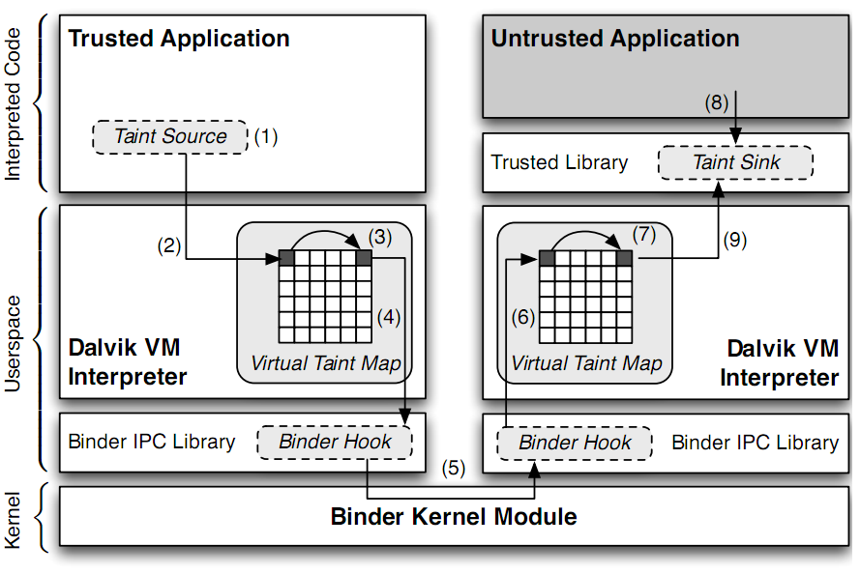
TaintDroid Data Flow
Notes:
Sensitive information is ﬁrst identiﬁed at a taint source, where a taint marking indicating the information type is assigned. Dynamic taint
analysis tracks how labeled data impacts other data in a way that might leak the original sensitive information.
Finally, the impacted data is identiﬁed before it leaves the system at a taint sink (usually the network interface).
possible false positive

Slide 26
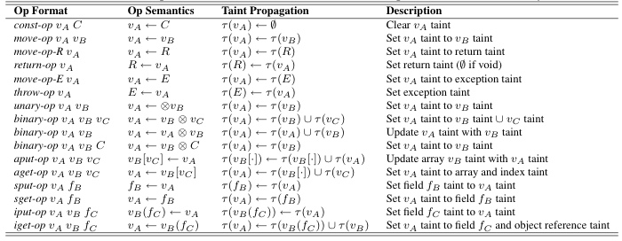
Taint Propagation

Slide 27

Defending Malicious Input

Slide 28
Two Usages of Data Flow Tracking
Usage-1: protect critical data
  E.g., track data to ensure none is leaked
Usage-2: defend against suspicious input data
  E.g., one input data cannot flow to return address!

Slide 29
How does a Hacker Search a Bug?
Step-0: Chose a library (open-source, of course)
  Let's try ffmpeg, which is used in Chrome, VLC, Mplayer...
  There are also rumors that YouTube uses it for conversion
Step-1: List the demuxers of ffmpeg
Step-2: Identify the input data
Step-3: Trace the input data

Slide 30
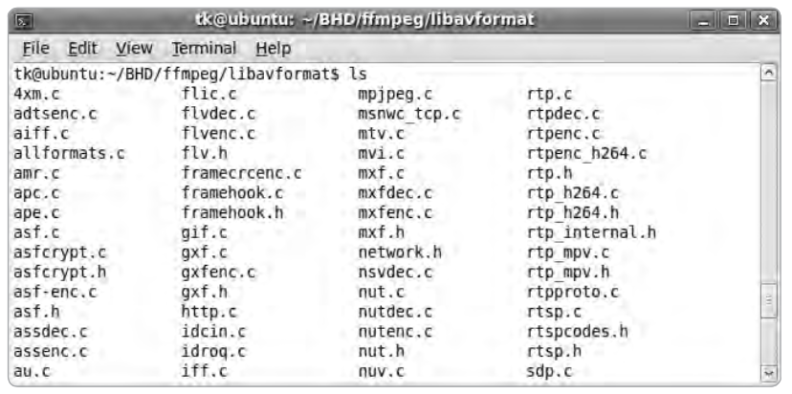
Step-1: List the Demuxers of FFmpeg

Slide 31

Step-2: Identify the Input Data
demuxername_read_header()
  Most demuxers declear a function called it
  Takes a parameter of type AVFormatContext
  This function initializes a pointer:
  Many different get_something() are used to extract pb data
    E.g., get_le32(), get_buffer()
  Conclusion: pb is a pointer to the input data of media files

Slide 32
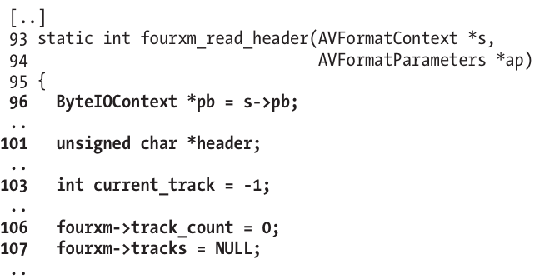
Step-3: Trace the Input Data
Start to read the first demuxer: libavformat/4xm.c

Slide 33
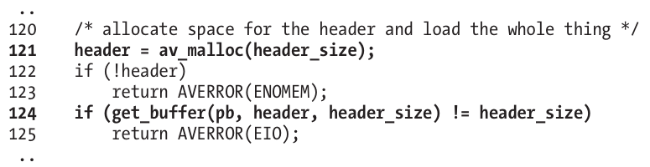
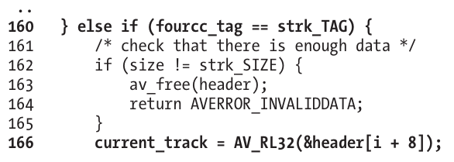
int
unsigned int

Slide 34
Step-3: Trace the Input Data
Supplying a value >= 0x80000000 for current_track causes a change in sign that results in current_track being interpreted as negative
The if statement in line 167 will always return FALSE
Thus, the buffer allocation in line 171 will never be reached

Slide 35
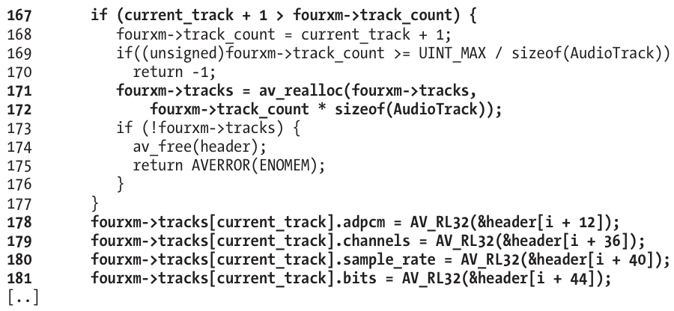
Step-3: Trace the Input Data

Slide 36
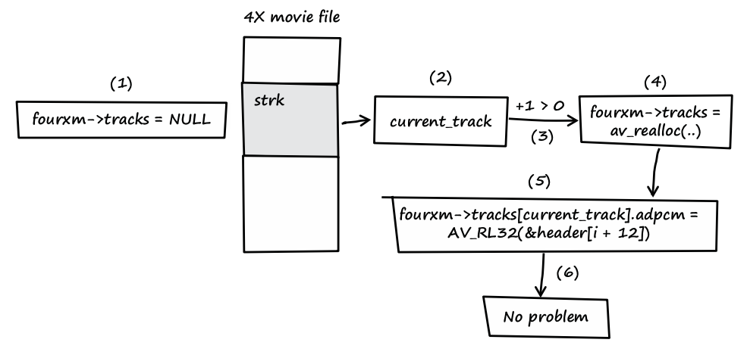
Step-3: Trace the Input Data
Notes:
fourxm->tracks is initialized with NULL (see line 107).
If the processed media file contains a strk chunk, the value of current_track is extracted from the user-controlled data of the chunk (see line 166).
If the value of current_track + 1 is greater than zero, a heap buffer is allocated.
The heap buffer pointed to by fourxm->tracks is allocated (see lines 171 and 172).
Data from the media file is copied into the heap buffer, while current_track is used as an array index into the buffer (see lines 178–181).
When this behavior occurs, there is no security problem.

Slide 37
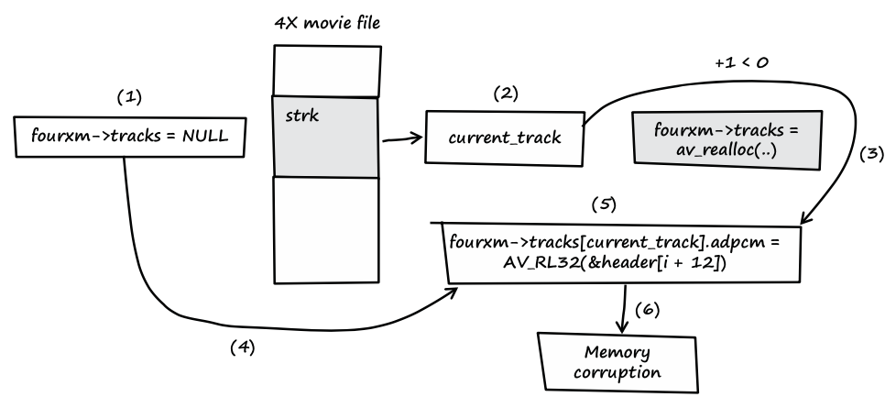
Step-3: Trace the Input Data
Notes:
fourxm->tracks is initialized with NULL (see line 107).
If the processed media file contains a strk chunk, the value of current_track is extracted from the user-controlled data of the chunk (see line 166).
If the value of current_track + 1 is less than zero, the heap buffer isn't allocated.
fourxm->tracks still points to memory address NULL.
The resulting NULL pointer is then dereferenced by the user- controlled value of current_track, and four 32-bit values of user- controlled data are assigned to the dereferenced locations (see lines 178–181).
Four user-controlled memory locations can be overwritten with four user-controlled data bytes each.

Slide 38
Question
How can we use taint tracking to find such bugs?

Slide 39
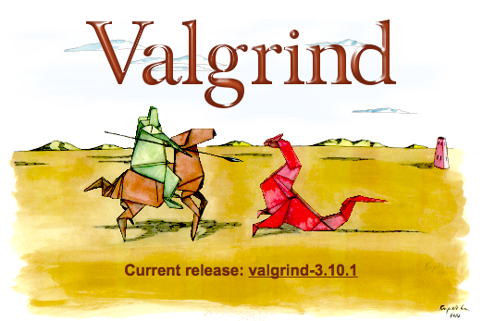
TaintCheck: Basic Ideas
Program execution normally derived
from trusted sources, not attacker input
Mark all input data to the computer as "tainted" (e.g., network, stdin, etc.)
Monitor program execution and track how tainted data propagates (follow bytes, arithmetic operations, jump addresses, etc.)
Detect when tainted data is used in dangerous ways

Slide 40
Add Taint Checking code
TaintCheck first runs the code through an emulation environment (Valgrind) and adds instructions to monitor tainted memory
X86 instructions
UCode
Binary re-writer
Taint Check
X86 instructions
UCode
Dynamic taint analysis

Slide 41
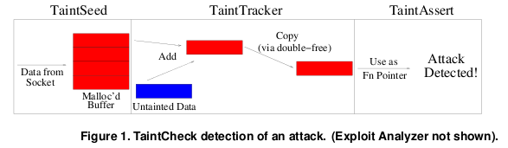
TaintCheck Detection Modules
TaintSeed: Mark untrusted data as tainted
TaintTracker: Track each instruction, determine if result is tainted
TaintAssert: Check is tainted data is used dangerously

Slide 42
Performance Evaluation – CPU Bound Process
Hardware: 2.00 GHz Pentium 4, 512 MB RAM, RedHat 8.0
Application: bzip2(15mb)
  Normal runtime 8.2s
  Valgrind nullgrind skin runtime: 25.6s (3.1x)
  Memcheck runtime: 109s (13.3x)
  TaintCheck runtime: 305s (37.2x)

Slide 43
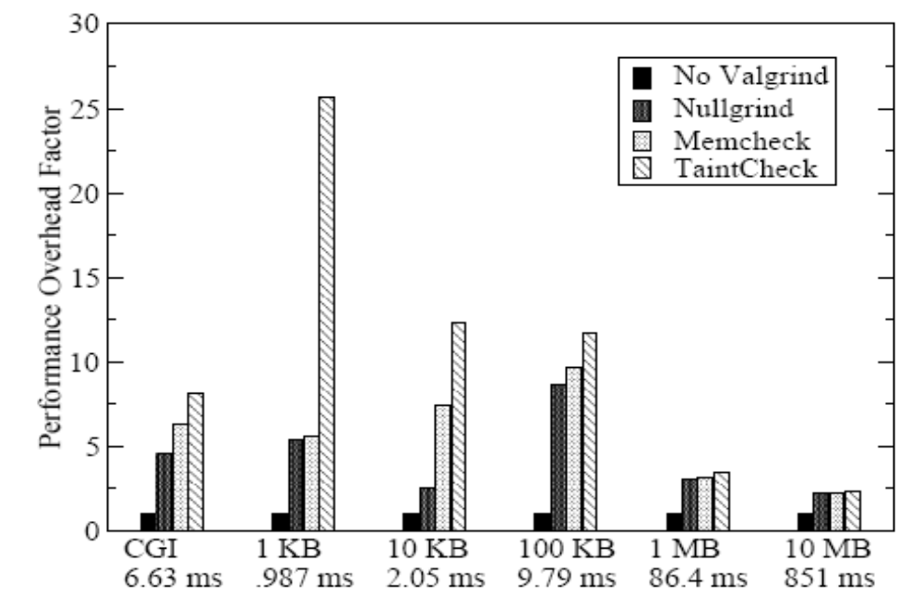
Performance Overhead of Apache
A more representative case, network and I/O
Better performance

Slide 44
Secure Channel

Slide 45
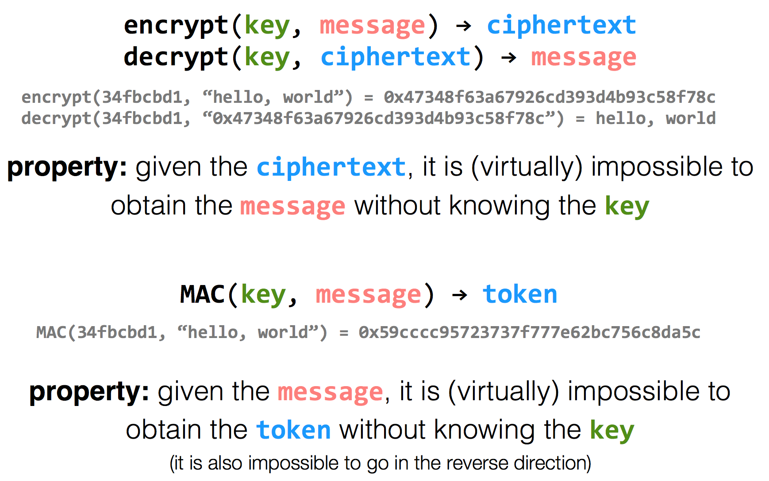
Encryption Properties

Slide 46
has k
has k
k=key
m=message
Alice
Bob
c = encrypt(k, m)
h = MAC(k, m)
c | h
m = decrypt(k, c)
MAC(k, m) == h ?

Slide 47
has k
has k
Alice
Eve
Bob
c = encrypt(k, m)
h = MAC(k, m)
c | h
m = decrypt(k, c)
MAC(k, m) == h ?
c | h
Problem: replay attacks
(adversary could intercept a message, re-send it at a later time)
c | h

Slide 48
has k
has k
Alice
Bob
c = encrypt(k, m | seq)
h = MAC(k, m | seq)
c | h
m | seq = decrypt(k, c)
MAC(k, m | seq) == h ?

Slide 49
has k
has k
Alice
Eve
Bob
c = encrypt(k, m | seq)
h = MAC(k, m | seq)
c | h
m | seq = decrypt(k, c)
MAC(k, m | seq) == h ?
c | h
if reuse seq
(e.g., date)
problem: reflection attacks
(adversary could intercept a message, re-send it later in the opposite direction)
Notes:
But if receiver is also sending to the sender (i.e., if they're both sending), the receiver might use that sequence number. So adversary could replay in the other direction (a "reflection" attack) - Solution: Use different keys in each direction

Slide 50
has k_{a} & k_{b}
has k_{a} & k_{b}
Alice
Bob
c_{a} = encrypt(k_{a}, m_{a} | seq_{a})
h_{a} = MAC(k_{a}, m_{a} | seq_{a})
c_{a} | h_{a}
m_{a} | seq_{a} = decrypt(k_{a}, c_{a})
MAC(k_{a}, m_{a} | seq_{a}) == h_{a} ?
c_{b} = encrypt(k_{b}, m_{b} | seq_{b})
h_{b} = MAC(k_{b}, m_{b} | seq_{b})
c_{b} | h_{b}
m_{b} | seq_{b} = decrypt(k_{b}, c_{b})
MAC(k_{b}, m_{b} | seq_{b}) == h_{b} ?

Slide 51
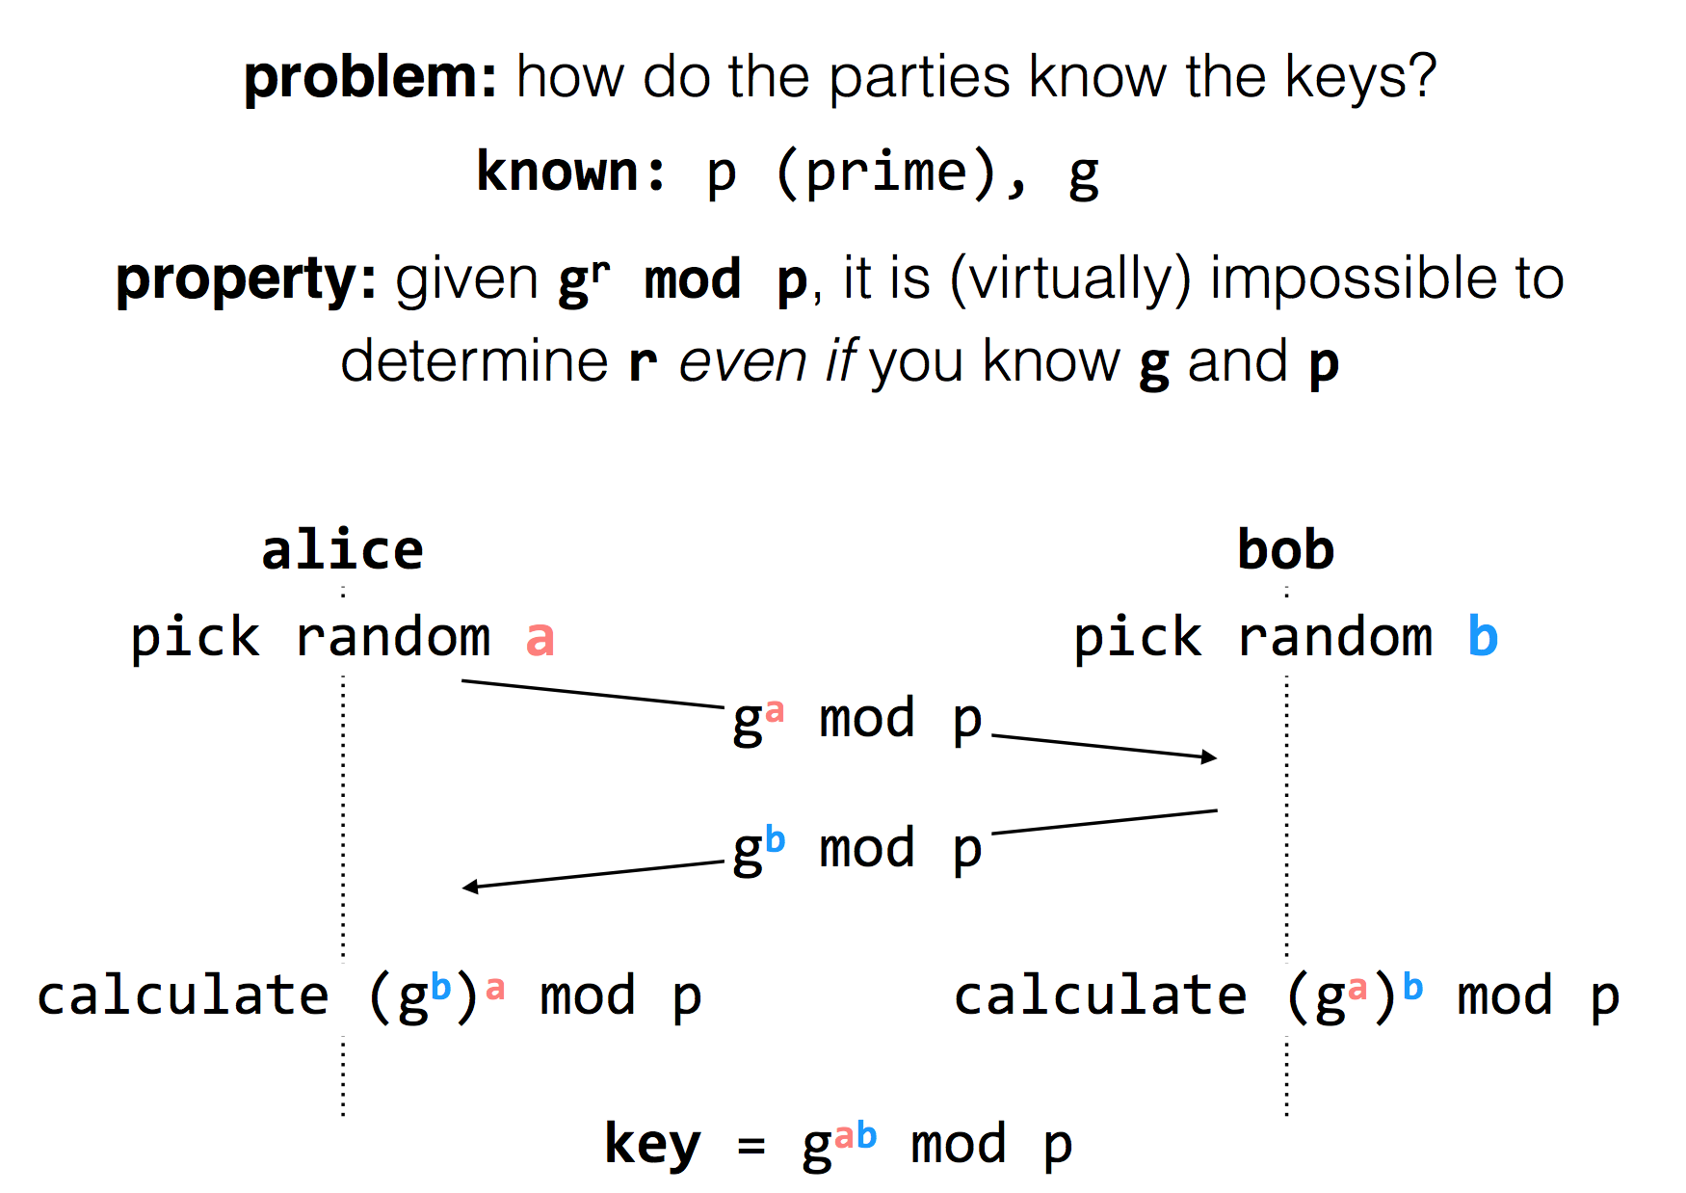
Diffie-Hellman
Key Exchange
(g^{b} mod p)ª mod p = g^{ab} mod p = (gª mod p)^{b} mod p
Notes:
g^i mod p ≠ g^j mod p （p为素数），其中i≠j且i, j介于1至(p-1)之间，则g为p的原根

Slide 52
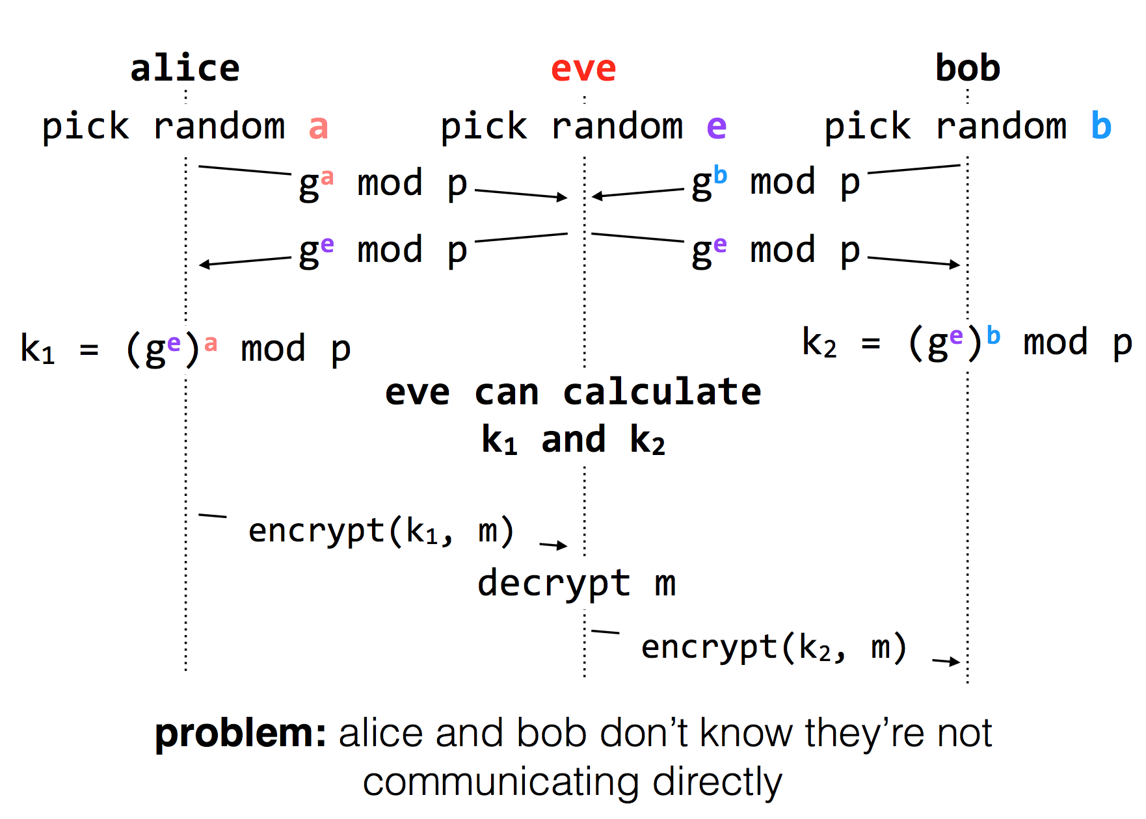
Diffie-Hellman Key Exchange & Man-in-the-Middle

Slide 53
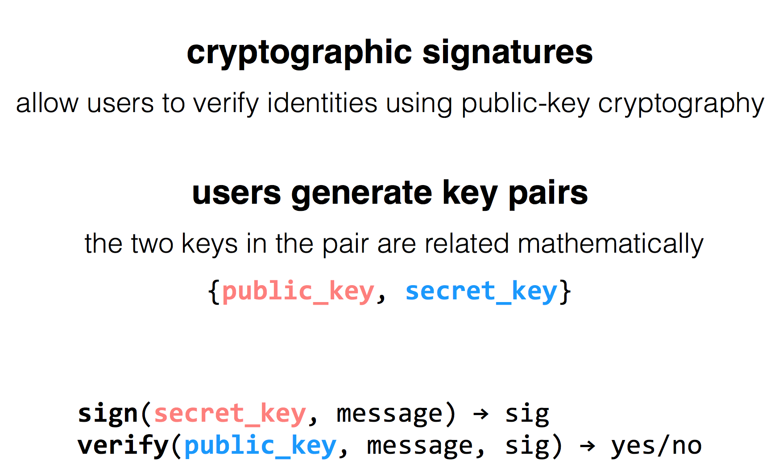
RSA Algorithm

Slide 54
Public Key Distribution
1. Alice remembers the key she used last time
  Easy to implement
  Effective against subsequent man-in-the-middle attacks
  Doesn't protect against MITM attacks the first time around
  Doesn't allow parties to change keys
2. Consult some authority that knows everyone's public key
  Does not scale (client asks for a PK for every new name)
  Alice needs server's public key beforehand

Slide 55
Public Key Distribution
3. Authority, but pre-compute responses
  Authority creates signed messages: {Bob, PK_bob}_{SK_as}
  Anyone can verify the authority signed this message, given PK_as
  When Alice wants to talk to Bob, she needs a signed message from the authority, but it doesn't matter where this message comes from as long as the signature checks out
    I.e., Alice could retrieve the message from a different server
  This signed message is a certificate
  More scalable

Slide 56
Review: Two Types of Encryption
Symmetric key encryption
  Single key (symmetric) is shared between parties, kept secret from everyone else
  Ciphertext = (M)^K
Asymmetric key encryption
  Keys come in pairs, public and private
  Secret: (M)^K-public
  Authentic: (M)^K-private

Slide 57
Questions on Certificate Authorities
Who should run the certificate authority?
How does the browser get this list of CAs?
  Generally they come with the browser
How does the CA build its table of names <-> public keys?
  Have to agree on how to name principals, and
  Need a mechanism to check that a key corresponds to a name
What if a CA makes a mistake?
  Need a way to revoke certificates: Expiration date? Not useful for immediate problems
  Publish certificate revocation list? Works in theory, not as well in practice
  Query online server to check certificate freshness? Not a bad idea
Notes:
Alternative: avoid CAs by using public keys as names (protocols: SPKI/SDSI)
Works well for names that users do not have to remember/enter

Slide 58
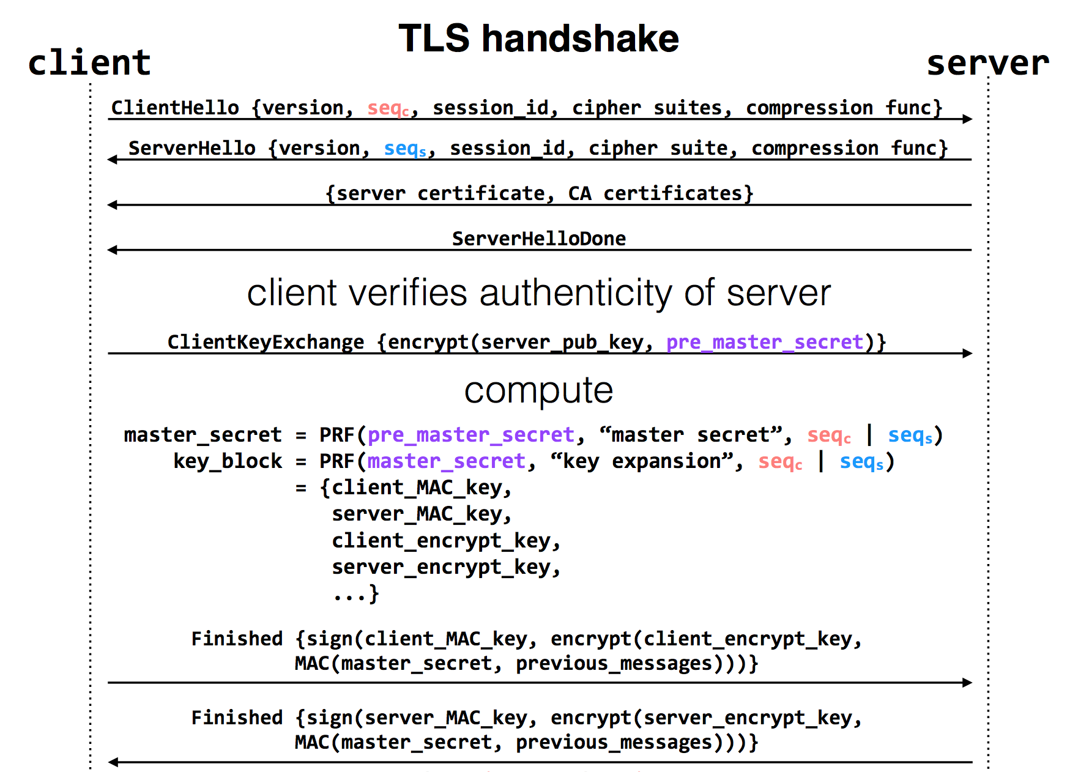
Notes:
pre-master-key is a random number
PRF: pseudo random function
Master key is a 48-byte sequence
https://crypto.stackexchange.com/questions/1139/what-is-the-purpose-of-four-different-secrets-shared-by-client-and-server-in-ssl

Slide 59
Privacy

Slide 60
Data Privacy
Data can be used everywhere
  Risk management
  Medicine
  Recommended system
  …
Data can be stolen easily
  Everyone who uses your data can steal it

Slide 61
Data Privacy
What’s the target of data privacy system?
  Allow data to be used, and protect it from being stolen
Today's contents
  Basic data privacy method
    ZKP, OT, HE, sMPC, TEE, DP
  Systems which try to enforce data privacy

Slide 62
Common Attacks
An adversary may learn about data:
From ciphertext (ciphertext representation-based attack, e.g., order of values)
From prior knowledge of data distribution (frequency-count attack)
From knowledge of frequency of queries (workload-skew attack)
From the size of the output to a query (output-size attack)
From the access pattern used by the mechanism in answering a query (access-pattern attack)
From knowledge of queries that have executed (search-pattern attack)
Mix with adversarial background knowledge
Data Privacy compromised!!

Slide 63
OT
Oblivious Transfer

Slide 64


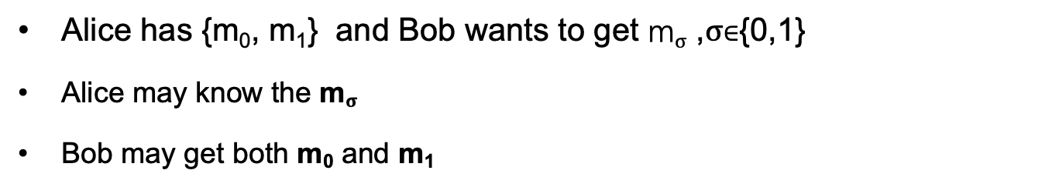
Problem
I have {m₀, m₁}
I want to get m$σ$
Alice
Bob
Alice has {m₀, m₁} and Bob wants to get m$σ$ ,$σ$∈{0,1}
Alice may know the m$σ$
Bob may get both m₀ and m₁

Slide 65
Oblivious Transfer (OT)
Introduced by Michael O. Rabin, 1981
Scenario: message transfer
  A sender has a message list {m₀, m₁, … , m_{n}}
  A receiver wants to get k target messages from sender
Properties: oblivious and secure
  Oblivious: sender cannot know which messages are received
  Secure: receiver can only get the target messages

Slide 66
1-out-of-2 OT
Scenario: RSA encryption
{m₀, m₁}
m$σ$ = ?
Alice
Bob
Generate 2 key pairs {K0_{pub}, K0_{prv}}, {K1_{pub}, K1_{prv}}
K0_{pub}, K1_{pub}
Generate a random number r
c ← Enc(Kσ_{pub}, r)
c
k₀ ← Dec(K0_{prv}, c)
k₁ ← Dec(K1_{prv}, c)
e₀ ← k₀ ⊕ m₀
e₁ ← k₁ ⊕ m₁
e₀, e₁
m_{σ} ← e_{σ} ⊕ r

Slide 67
1-out-of-2 OT (Solution-2)
m$σ$ = ?
{m₀, m₁}
Alice
Bob
Generate ${(K}_{pub}, K_{prv})$
Select random numbers $r_{0},$ $r_{1}$
$$K_{pub}, r_{0},r_{1}$$
Genearte a key $k$
$V=Enc\left(K_{pub}, k\right)⊕r_{σ}, σ∈\{0,1\}$
$$V$$
$k_{0}=Dec\left(K_{prv},V⨁{ r}_{0}\right)$
$k_{1}=Dec\left(K_{prv},V⨁{ r}_{1}\right)$
$C_{0}=Enc\left(k_{o}, { m}_{0}\right)$
$C_{1}=Enc\left(k_{1}, { m}_{1}\right)$
$$C_{o},C_{1}$$
$m_{σ} =Dec\left(k, C_{σ}\right)$
Notes:
Alice分别用两个解密结果加密她的两份消息，将加密结果送给Bob （Ci=E(ki, mi) i=0,1）
Bob用k解密两份密文，得到需要的秘密 s

Slide 68
More OT Protocols
Different numbers of selected messages
  1-out-of-2 OT
  1-out-of-n OT
  k-out-of-n OT
Implementation method
  Non-adaptive OT
  Adaptive OT
  Publicly Verifiable OT
  …

Slide 69
DP
Differential privacy

Slide 70


Problem
Name | Salary
Alice | 100
Bob | 80
Brown | 200
Tom | 120
SUM(Salary)
500
Alice can perform queries on Bob’s database, but cannot access a single database entry

Slide 71
Problem
Name | Salary
Alice | 100
Bob | 80
Brown | 200
Tom | 120
SUM(Salary) where Name == “Tom”
Reject
Alice can perform queries on Bob’s database, but cannot access a single database entry
  Naïve method: reject Alice to access single entry

Slide 72
Problem
Tom has 120
Name | Salary
Alice | 100
Bob | 80
Brown | 200
Tom | 120
SUM(Salary)
500
SUM(Salary) where Name != “Tom”
380
Alice can perform queries on Bob’s database, but cannot access a single database entry
  Naïve method: reject Alice to access single entry

Slide 73
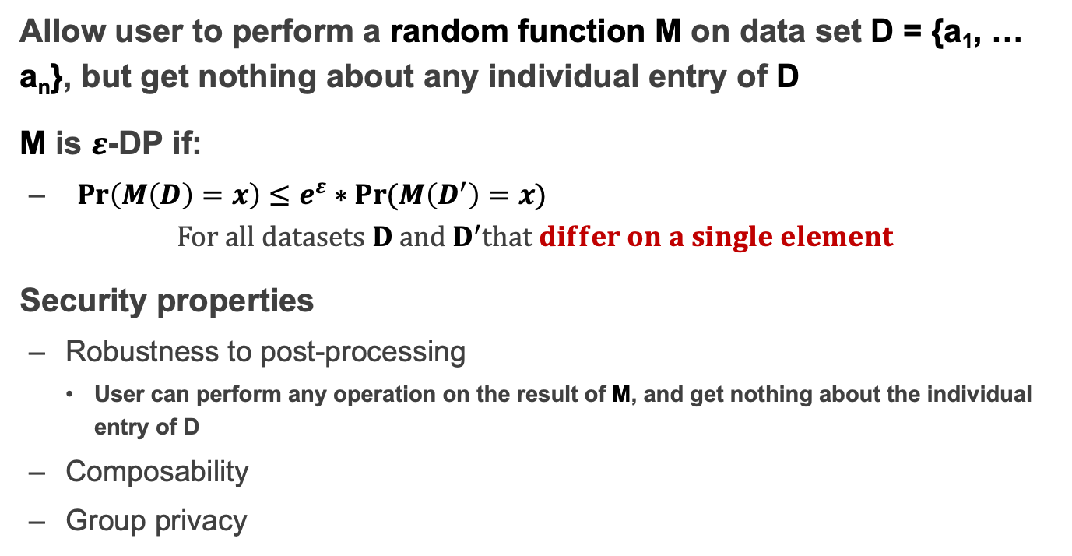
Differential privacy
Allow user to perform a random function M on data set D = {a₁, … a_{n}}, but get nothing about any individual entry of D
M is $ε$-DP if:
  ${Pr\left(M\left(D\right)=x\right)}≤e^{ε}∗Pr⁡(M\left(D^{′}\right)=x)$
  $For all datasets D and D^{′}that differ on a single element$
Security properties
  Robustness to post-processing
    User can perform any operation on the result of M, and get nothing about the individual entry of D
  Composability
  Group privacy

Slide 74
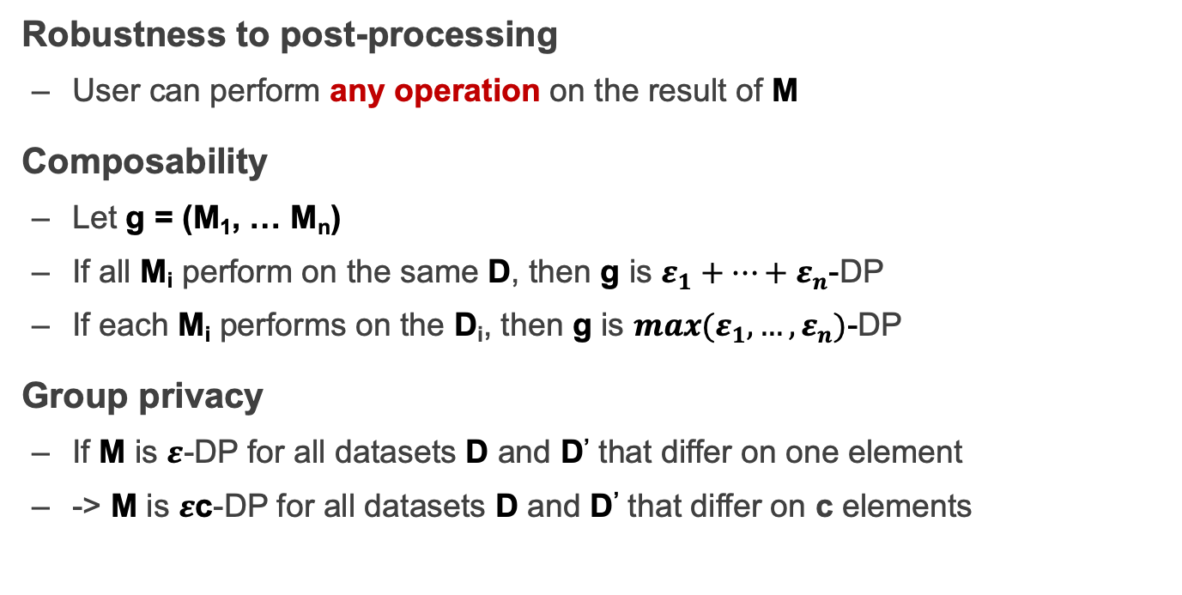
Properties of Differential privacy
Robustness to post-processing
  User can perform any operation on the result of M
Composability
  Let g = (M₁, … M_{n})
  If all M_{i} perform on the same D, then g is $ε_{1}+…+ε_{n}$-DP
  If each M_{i} performs on the D_{i}, then g is ${max(ε}_{1},…,ε_{n})$-DP
Group privacy
  If M is $ε$-DP for all datasets D and D’ that differ on one element
  -> M is $ε$c-DP for all datasets D and D’ that differ on c elements

Slide 75
How to Implement a DP Algorithm
Adding noisy to the function that we want to compute
  Translate the function f to a random algorithm M
Existing Mechanism
  Laplace mechanism
  Gaussian mechanism
  …

Slide 76
When DP is Enabled
…
Name | Salary
Alice | 100
Bob | 80
Brown | 200
Tom | 120
SUM(Salary)
~480
SUM(Salary) where Name != “Tom”
~480

Slide 77
Secret Sharing

Slide 78
Secret Sharing
Introduced by Adi Shamir, 1979
Key Insight: One point constructs infinite number of lines, two points construct only one line
Key Idea: Split a secret data into n shares, at least k shares can reconstruct the secret ((k,n)-SS)

Slide 79

Secret Sharing
Each part cannot learn the secret S
Secret-Share Creation:
(under the assumption that no part will collude)
share 1
part 1
share 2
secret data S
part 2
share 3
secret owner
share n
part 3
Mathematical operations
f(x) = S + a₁x + a₂x + ... + a_{k-1}x^{k-1}
…
part n

Slide 80
Secret Sharing
Each part cannot learn the secret S
Secret Reconstruction:
(under the assumption that no part will collude)
share 1
part 1
share 2
secret data S
part 2
share k
secret owner
part 3
Lagrange Interpolation
…
part n

Slide 81
Secret Sharing
Each part cannot learn the secret S
Secret Reconstruction:
(under the assumption that no part will collude)
share 1
part 1
secret data S
part 2
share 3
share k
secret owner
part 3
Lagrange Interpolation
…
part n

Slide 82
Pros and Cons
An information-theoretically secure protocol (unconditionally secure, independent of adversary's computational capabilities → quantum-safe)
Ideal assumption (At least k parts never collude)
Communication overhead

Slide 83
Secure MPC
Multi-Party Computing

Slide 84
secure Multi-Party Computation (sMPC)
We want to calculate
f(data₁, data₂)
I have data₁
I have data₂
Alice
Bob
Multiple parties (at least 2) work together to calculate a function
  Enforce the data privacy for each party

Slide 85
Millionaire Problem
Money: Bob has i, Alice has j, i and j are between 1 to 10
Alice
Bob
  Chose a random big integer x
  K = enc{Key_{pub} of Bob, x}
  Decrypt with Key_{prv} of Bob ten number: c+1, c+2...c+10, get y1, y2... y10
  Chose a prime number p
  Calculate d1 = y1 mod p,
  d2 = y2 mod p, ...
  For n=i to 10, d_{n}++, other no change
c=K-j
d₁ to d₁₀
  Check dj, if dj == x mod p, then i > j; else i <= j

Slide 86
secure Multi-Party Computation (sMPC)
Semi-honest adversary
  Each party must follow the protocol
Generic protocol
  Can securely compute any functionality
Multi-party computation
  Secret sharing
2-party computation
  GC(Garbled Circuits) + OT(Oblivious Transfer)

Slide 87
HE
Homomorphic Encryption

Slide 88

Problem
I have Data!
I have computing resource!
Data
Alice
Bob (cloud)
Alice wants to ask Bob (e.g., a cloud) to perform calculation on her data
Naïve method: Sending Data to Bob
  Bob will get the data

Slide 89
Homomorphic Encryption (HE)
I have Data!
I have computing resource!
Alice
Bob (cloud)
CT=encrypt(Key, Data)
Function f()
CT'= Evaluate(f, CT) = Encrypt(Key, f(Data))
Get f(Data) = Decrypt(Key, CT')

Slide 90
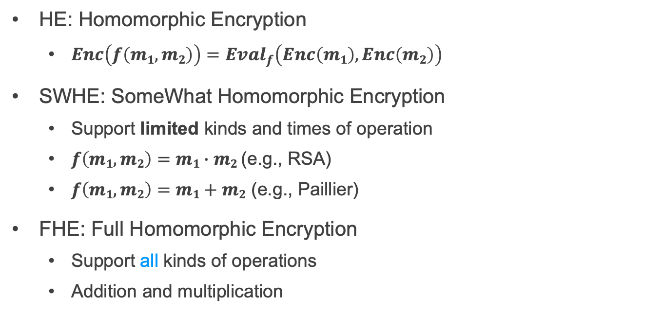
SWHE and FHE
HE: Homomorphic Encryption
  $Enc\left(f\left(m1,m2\right)\right)={Eval}_{f}\left(Enc\left(m1\right), Enc\left(m2\right)\right)$
SWHE: SomeWhat Homomorphic Encryption
  Support limited kinds and times of operation
  $f\left(m1,m2\right)=m1∙m2$ (e.g., RSA)
  $f\left(m1,m2\right)=m1+m2$ (e.g., Paillier)
FHE: Full Homomorphic Encryption
  Support all kinds of operations
  Addition and multiplication

Slide 91
TEE
Trusted Execution Environment

Slide 92
Problem
I have Data!
I have computing resource!
Data
Alice
Bob (cloud)
Alice wants to ask Bob (e.g., a cloud) to perform calculation on her data
Naïve method: Sending Data to Bob

Slide 93
Trusted Execution Environment (TEE)
I have Data!
I have computing resource and TEE!
Data
Alice
Bob (cloud)
Alice wants to ask Bob (e.g., a cloud) to perform calculation on her data
Naïve method: Sending Data to Bob
Bob cloud construct a TEE

Slide 94
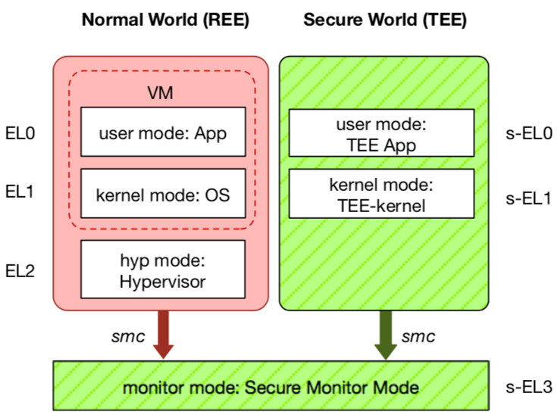
TEE: Trusted Execution Environment
Widely deployed on mobile devices
  Every Android device must deploy TEE
  Mostly based on ARM TrustZone
An isolated & privileged environment
  TEE can access all DRAM & peripherals
  REE cannot access TEE's resources
Designed to be secured and small
  For security-critical tasks (e.g., fingerprint
  checker, mobile payment, etc.)
Notes:
Before presenting virtualization of TEE, let me introduce TEE a little bit.
TEE is short for xxx. It has been widely deployed on mobile devices. Thanks to Google, now every Android phone needs to have TEE to pass Google's test.
On mobile phone, most TEE are based on ARM TrustZone.
TrustZone divides one system to two worlds: xxx and xxx.
The normal world, aka REE, runs rich OS like Android or iOS. It has three layers: one for hypervisor, one for kernel and one for application.
The secure world, aka TEE, has three layers: one for TEE OS and one for TEE applications.
There is a special layer, called monitor mode or s-EL3, is used for switching between the two worlds. It is also part of the secure world but share the same privilege with s-EL1.
The switching is done through smc instruction.
The green part is TEE, which is an isolated environment with higher privileged than the REE.
It means that xxx
The TEE is designed to xxx, its typical usage is xxx.

Slide 95
Two Features of TEE
1. Isolated execution
Minimal TCB: system software is not trusted
  E.g., OS and hypervisor
Some can prevent physical attacks
  With memory encryption
2. Remote attestation
Prove itself to the end users
Usually use SSL to establish a secure channel over network

Slide 96
Different TEEs
Software TEE
  VM-based TEE
  Same privilege protection
ARM TrustZone
Intel SGX
AMD SME/SEV
SANCTUM
Notes:
However, the openness also leads to fragmentation.
Nowadays, there are many different kinds of TEE OS, from different venders.
Also, many other implementations based on OP-TEE.
This is not a good news for trusted app developers, since they need to port and trust.

Slide 97
Process of Bug Report

Slide 98
Process of fixing a bug/vulnerability
1 发现
2 汇报
Based on a real case (Credit: Fan Yang)
  CVE-2020-10757
  Linux commit 5c7fb56e5e3f
Phase-1: finding a bug
  Survey whether the bug has been found
  Simply the process of re-producing bug
  Evaluate the seriousness, if belongs to security, offer an exploit
  Provide a patch if you have one.
3 处理
4 公开
TCB: Yourself

Slide 99
Fix the Bug
1 发现
2 汇报
3 处理
4 公开
Phase-2: Report
  Not security bug：kernel mailing list, bugzilla
  Security bug：security@kernel.org
  Require a CVE id (Common Vulnerability and Exposures List)
    Not public yet
    CVE status is RESERVED
public
Non-public
TCB: Mailing list + Yourself

Slide 100
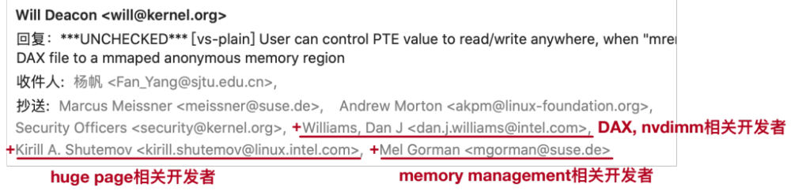
Fix the Bug
1 发现
2 汇报
3 处理
4 公开
Phase-3: handle the bug
  Related developers and maintainers join the discussion
TCB: Related developers + Mailing list + Yourself

Slide 101
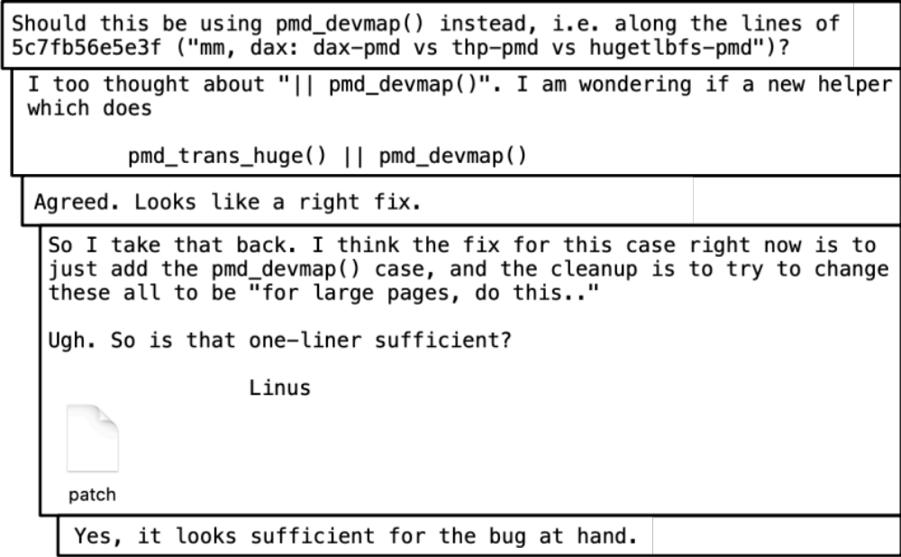
Fix the Bug
1 发现
2 汇报
3 处理
4 公开
Phase-3: handle the bug
  Patch proposing and discussion

Slide 102
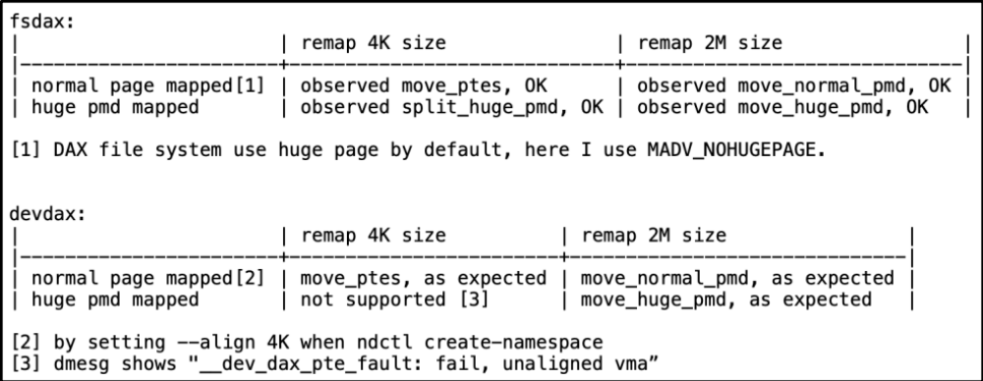
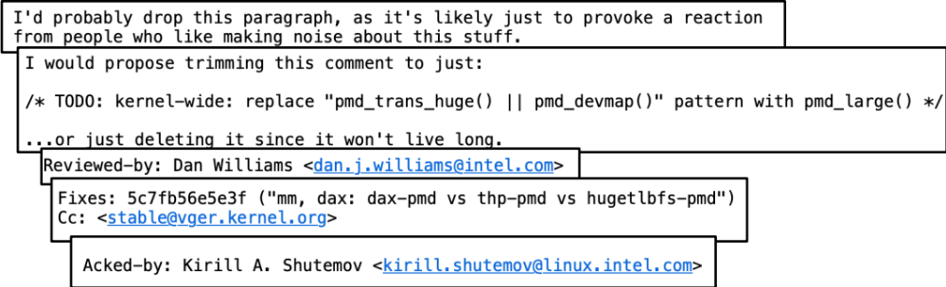
Fix the Bug
1 发现
2 汇报
3 处理
4 公开
Phase-3: handle the bug
  Test and patch review

Slide 103
Fix the Bug
1 发现
2 汇报
3 处理
4 公开
Phase-3.5：Embargo Period （可选）
  discuss with maintainers of distributions, prepare to fix
  Why not just fix it?
    Submit a patch in public mailing list means public
    Prevent distributions not fix the bugs in time
  Decide whether embargo period is needed: evaluate
3.5 Embargo

Slide 104

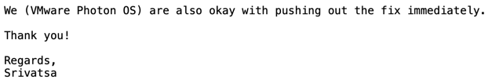
Fix the Bug
1 发现
2 汇报
3 处理
4 公开
Phase-3.5：Embargo Period
  You can negociate Embargo Period
3.5 Embargo
TCB: Distributions + Related developers + Mailing list + Yourself

Slide 105

Fix the Bug
1 发现
2 汇报
3 处理
4 公开
3.5 Embargo
Phase-4: Public
  Merge to mainstream
  Backport to related stable versions
  Publish to public mailing list, security group
    E.g., oss-security@lists.openwall.com
  Update CVE status to public
TCB: All!

